Slide 1



Green Procurement
IN4BLUE
January, 26, 2026 – prof. Fabrizio Baldassarre

Slide 2
If you plan for a year, plant a seed.
If you plan for ten years, plant a tree.
IN4BLUE
If you plan for a hundred years, teach the people.
(Kuan-Tzu)

Slide 3



What comes to your mind when you hear “green or sustainable procurement”?
Do not edit
How to change the
design
The Slido app must be ins^{IN}t⁴a^{B}l^{L}l^{U}e^{E -}d^{Fa}o^{bri}n^{zio B}eªv^{lda}e^{ss}r^{ar}y^{re} computer you’re presenting from

Slide 4

How much does sustainability influence your purchasing decisions today?
Do not edit
How to change the
design
The Slido app must be ins^{IN}t⁴a^{B}l^{L}l^{U}e^{E -}d^{Fa}o^{bri}n^{zio B}eªv^{lda}e^{ss}r^{ar}y^{re} computer you’re presenting from

Slide 5
Sustainable & Green Procurement for SMEs
Green Procurement Playbook (WEF + Kearney)
ISO 20400 Sustainable Procurement Guidance
IN4BLUE - Fabrizio Baldassarre

Slide 6





Increasing regulatory and customer expectations
Cost efficiency through life-cycle thinking
Why Sustainable Procurement Matters for SMEs
Stronger and more resilient supply chains
Competitive advantage and improved reputation
Better access to tenders, partnerships and finance
IN4BLUE - Fabrizio Baldassarre

Slide 7
What Is Sustainable Procurement (ISO 20400)
Integrating sustainability into purchasing decisions
Considering environmental, social and ethical aspects
Creating long-term economic value Across the full procurement lifecycle
IN4BLUE - Fabrizio Baldassarre

Slide 8

Key Principles of ISO 20400
Accountability and transparency
Ethical behavior
Respect for human rights
Risk-based approach
Continuous improvement
Alignment with business strategy
IN4BLUE - Fabrizio Baldassarre

Slide 9
Green Procurement Playbook – SME Perspective
The Playbook emphasizes:
Practical and scalable actions
Business value, not only compliance
Progressive maturity models
Supplier engagement as a key impact lever
IN4BLUE - Fabrizio Baldassarre

Slide 10
Stages of Excellence overview: where are we?
The Stages of Excellence Assessment is a practical tool for assessing a company’s maturity with green procurement, helping them to understand where they stand and where to focus.
IN4BLUE
IV
III
Sustainability leader
II
Value creator
Procurement is recognized as a strategic driver of the company’s sustainability transformation.
CPO and team proactively shape ambition, influence enterprise-wide priorities and lead innovation.
Sustainability is institutionalized across tools, incentives, partnerships and culture.
Procurement decisions consistently deliver environmental and social impact alongside business results.
I
Risk manager
Procurement is aligned
with corporate sustainability goals and contributes through structured, measurable initiatives.
Sustainability is embedded in key procurement processes, governance and decision-making frameworks.
Collaboration across functions, suppliers and partners generates shared value.
Clear performance targets and KPIs link green procurement to business and sustainability outcomes.
Not yet started Compliance driver
Procurement supports company-wide sustainability through risk mitigation and foundational practices.
Selected tools, standards or processes are used
to address sustainability risks in operations and supply chain.
Leadership and cross- functional support are emerging but not yet consistent or embedded.
Sustainability is acknowledged as important, but not yet positioned as a driver of value.
Green procurement actions are reactive, limited to meeting basic regulatory or reputational expectations.
Sustainability is not integrated into procurement strategy, structures or decision-making.
Initiatives are fragmented and dependent on individual champions or external pressure.
No clear ownership, targets or incentives for sustainability within procurement.
Source: Kearney, 2025.

Slide 11
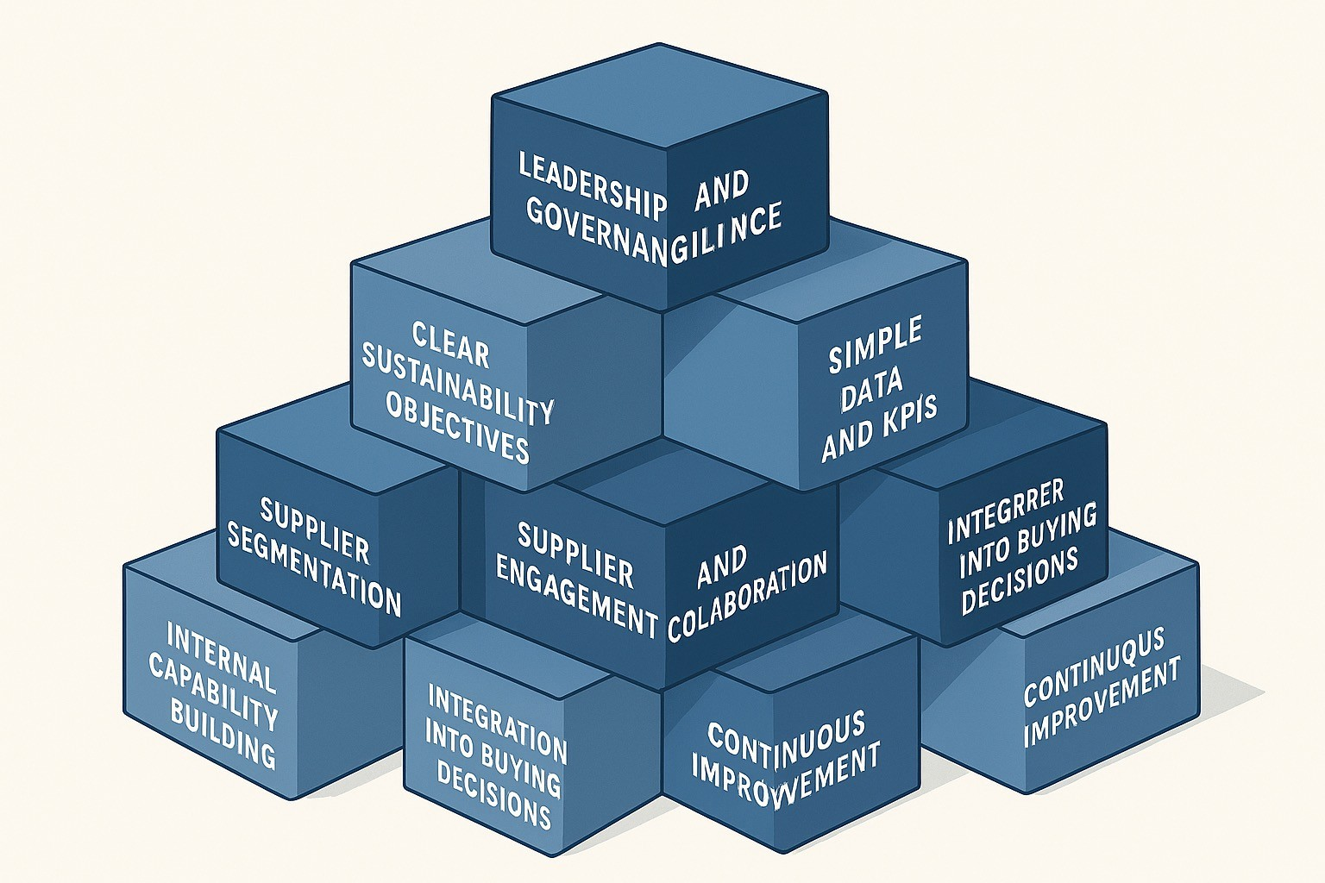
8 Building Blocks
Leadership and governance
Clear sustainability objectives
Simple data and KPIs
Supplier segmentation
Supplier engagement and collaboration
Internal capability building
Integration into buying decisions
Continuous improvement
IN4BLUE - Fabrizio Baldassarre

Slide 12
Sustainability considerations for the procurement process
IN4BLUE
Leading companies structure their approach around five key steps in the standard sourcing cycle
1
Pre-RFQ phase
2
RFQ design & launch
3
RFQ analysis & negotiations
Award planning
Supplier set
RFQ preparation
RFQ distribution
RFQ analysis
Supplier negotiations
Map emissions and risks to prioritize high- impact categories. Apply internal carbon pricing early to guide sourcing strategy. Align sustainability targets with procurement planning. | Use self-assessment tools to screen suppliers for sustainability. Build preferred lists of prequalified sustainable suppliers. Leverage third-party ratings to assess supplier maturity. | Embed sustainability criteria and PCF disclosure in RFx templates. Set minimum requirements (e.g. ISO 14001 certification). Define clear sustainability weighting in evaluation criteria. | Communicate expectations on emissions and data reporting. Share templates or toolkits to standardize supplier responses. | Adjust supplier quotes using carbon-adjusted pricing. Penalize missing PCF data with high default estimates. Use tools to compare suppliers based on emissions data. | Ask suppliers for emissions reduction plans and targets. Align on KPIs and reporting timelines during negotiations.
4
Awarding and contracting
5
Supplier management
Awarding
Contracting
Ongoing supplier engagement
Reward suppliers that lead on sustainability – even if costlier
Favour long-term alignment with decarbonization goals.
Include clauses on emissions reporting and improvement targets.
Require adherence to a supplier code of conduct.
Monitor emissions and progress with dashboards and PCF updates.
Conduct targeted sustainability audits where risk is high.
Use incentives and penalties to drive supplier performance.
Integrate sustainability into supplier reviews and scorecards.

Slide 13






Practical First Steps for SMEs
Define a basic sustainable procurement policy
Identify high- impact spend categories
Introduce minimum sustainability criteria
Start supplier self- assessments
Leverage existing certifications and standards
IN4BLUE - Fabrizio Baldassarre

Slide 14





Supplier engagement programme – standard approach
IN4BLUE
1
Establish emissions baseline and identify hotspots
2
3
Launch programme and define interaction model
4
Engage with suppliers and explore decarbonization levers
4
Segment and prioritize suppliers
Support suppliers and monitor progress
— Define data requirements and sources. | — Assess supplier sustainability maturity. | — Develop detailed supplier engagement plan. | — Identify category-specific levers and best practices. | — Offer training, resources and tools to support implementation.
— Create initial baseline via spend-based or average- data methods. | — Segment suppliers by sustainability and business criteria. | — Reach out to suppliers to align on targets and expectations. | — Conduct joint workshops to explore abatement strategies. | — Establish incentives and recognition programmes.
— Identify emission hotspots plotting supplier/category emissions. | — Define supplier archetypes and tailor engagement strategies. | — Secure supplier commitment to advance decarbonization efforts. | — Outline decarbonization roadmap (e.g. levers, milestones, targets). | — Set up reporting and monitoring systems to track progress.
— Improve accuracy over time by collecting direct supplier data. |  | — Define interaction model (e.g. resources, meetings, tools, point of contact). | — Develop business case to assess cost-benefit and impact. | — Share knowledge and best practice across suppliers.
 |  |  | — Secure buy-in from key sponsors (e.g. CFO, leadership team). | — Communicate progress on goals throughout the organization.
 |  |  | — Launch pilots to test feasibility, refine and scale up programmes.
Source: Net-Zero Value Chain Support Hub, 2024; Kearney, 2025.
Challenge intensity
Moderate
Critical
Regular

Slide 15





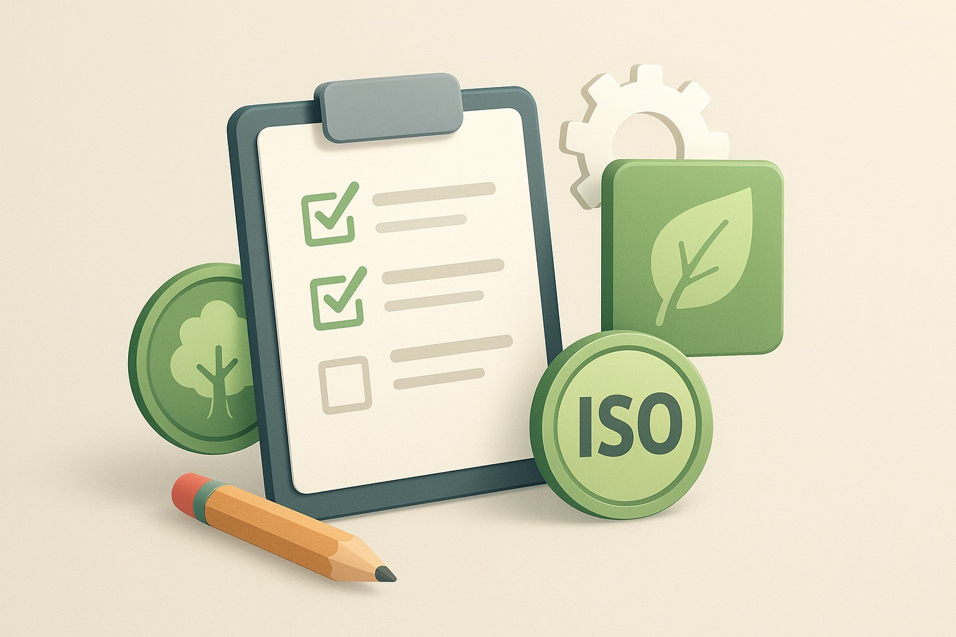
Tools SMEs Can Use Today
SUPPLIER CODE OF CONDUCT
•
BASIC LIFE CYCLE COSTING
(LCC)
•
ISO STANDARDS (9001, 14001,
45001)
SUSTAINABILITY QUESTIONNAIR ES
ENVIRONMENT AL LABELS (EU ECOLABEL, FSC, ETC.)
IN4BLUE - Fabrizio Baldassarre

Slide 16
IN4BLUE
Common green procurement KPIs
% of total spend with certified or sustainable suppliers
% of suppliers disclosing scope 1, 2
and 3 emissions
% of suppliers aligned with CDP or SBTi reporting
% of suppliers completing training or capability-building programmes
% of buyer performance reviews including sustainability KPIs
Total scope 3 emissions by procurement category
Average sustainability score across supplier base
% of RFx with sustainability criteria
% of awarded contracts with sustainability-linked clauses
% of key suppliers in decarbonization programmes/plans
% of procurement staff with sustainability training
% of supplier data entries verified through audits or third-party platforms
% of sustainably sourced % of suppliers and deforestation-free disclosing on waste
commodities and water performance
% of suppliers offering greener alternatives
to materials
% of suppliers using renewable
energy or green fuels
for production
Source: Kearney, 2025.

Slide 17




Benefits Across Sectors
Manufacturing: efficiency, cost
reduction, resource savings
Construction: regulatory
compliance, GPP alignment
Services: reputation, low implementation
cost
Retail & trade: transparency and customer trust
IN4BLUE - Fabrizio Baldassarre

Slide 18






Key Success Factors
Start small and scale gradually
Focus on material impacts
Engage suppliers
early
Align procurement
with
business strategy
Measure what really
matters
IN4BLUE - Fabrizio Baldassarre

Slide 19
Key Takeaways for SMEs
Sustainable procurement is:
A business opportunity, not just compliance
Feasible with limited resources
A continuous improvement journey Start now. Improve step by step.
IN4BLUE - Fabrizio Baldassarre

Slide 20




Tecnopolis PST
IN4BLUE
Prof. Fabrizio Baldassarre-University of Bari Aldo Moro
fabrizio.baldassarre@uniba.it
www.italy-croatia.eu/web/in4blue

