Slide 1
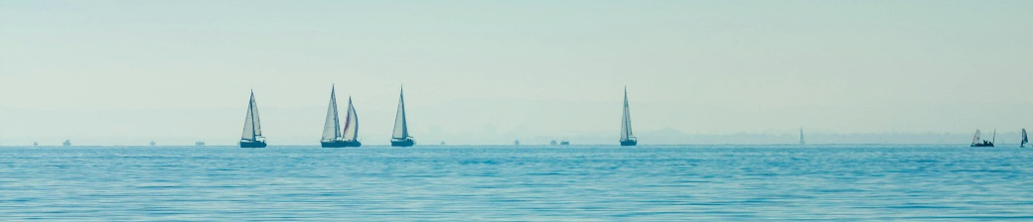


IN4BLUE
SUSTAINABILITY = PROFITABILITY
SEAFOOD ASSESSMENT|FABIJAN H PERONJA|WWF ADRIA
25.01.2026.

Slide 2
IN4BLUE
MARINE PROTECTION
Main threats:
Overfishing and IUU
Habitat degradation
Polution
Invasive species
Climate change

Slide 3
IN4BLUE
FISHING – IMENSE POTENTIAL, HUGE IMPACT
Food security, coastal development, cultural heritage
Direct and huge impact to biodiversity and marine habitats
SUSTAINABILITY = PROFITABILITY

Slide 4
IN4BLUE
FISHING FOR NUMBERS
Fishing drives a global industry worth $362 billion
The ocean absorbs 30% of CO₂ emissions
50% world’s population depends on fish as a primary source of protein

Slide 5
IN4BLUE
SUSTAINABLE PRODUCTS = MARKET POSITIONING
Western markets and other high-purchasing-power markets are willing to pay more for food sourced from sustainable origins – World Bank, 2020.
Global demand for fish and fishery products has increased significantly in recent years, awareness of the need to ensure supply without environmental and social issues throughout the entire fish value chain has also increased – FAO, 2020.

Slide 6
IN4BLUE
WHAT CAN WWF PROVIDE
1. Seafood assessment
2. Sustainability recommendations
3. Awareness raising
4. Policy and advocacy

Slide 7
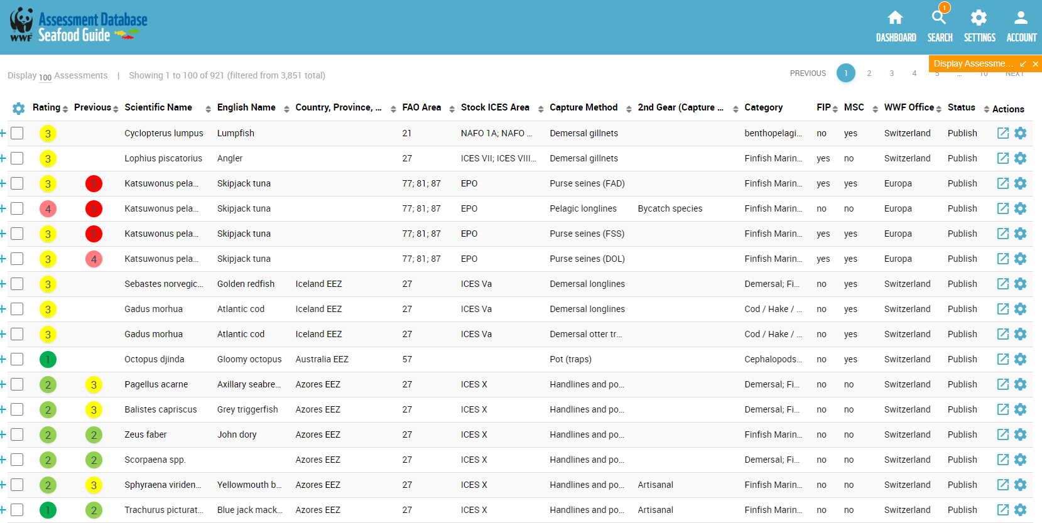
IN4BLUE

Slide 8
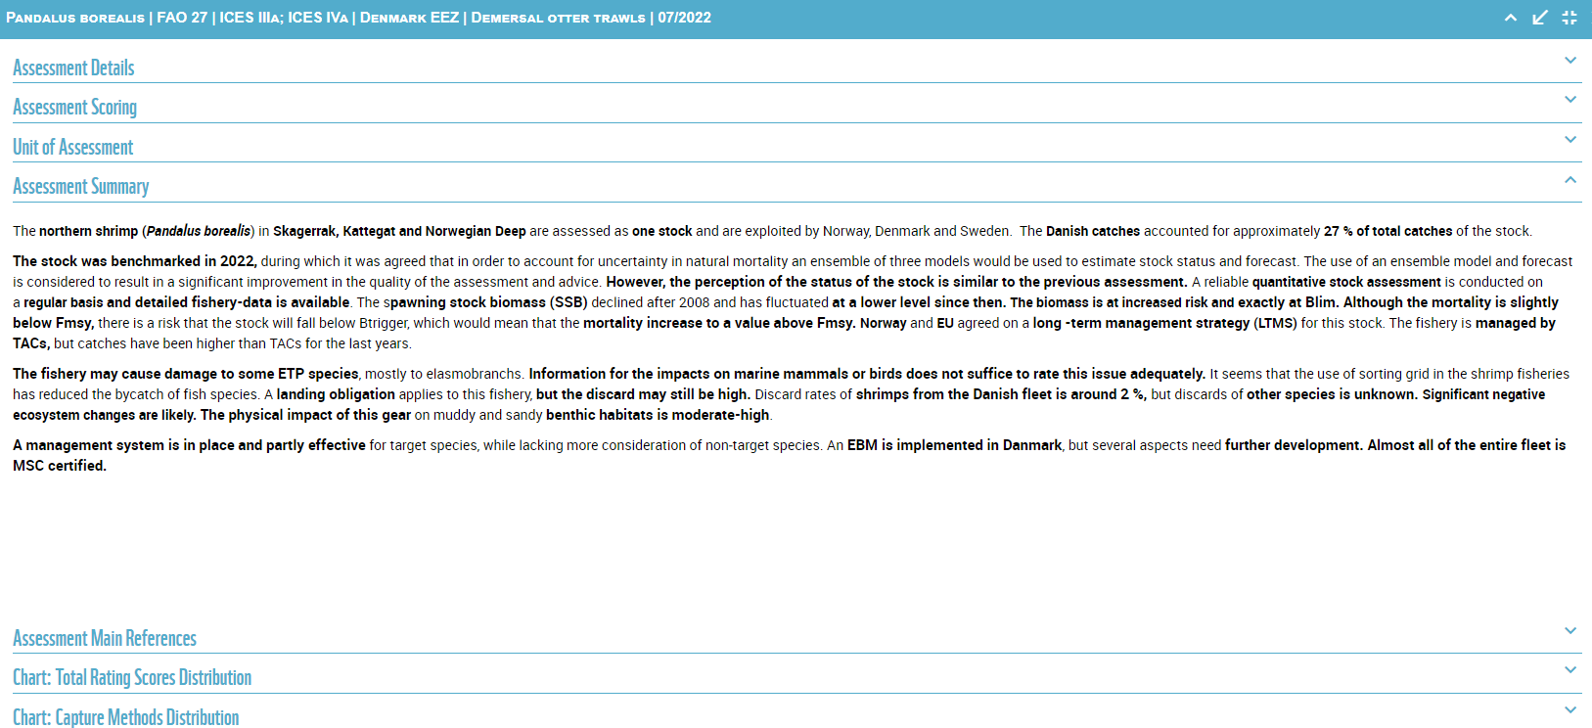
IN4BLUE

Slide 9
IN4BLUE
RESULTS?
Commitment to increase traceability and transparency
Commitment to take a leading market position in sustainable fisheries products
Commitment to continuous improvement of both volume and range of seafood sourced sustainable
Commitment to publish progress toward sustainability goals

Slide 10
IN4BLUE
WWF & PARTNERS
VALAMAR
LIDL GLOBAL
HILTON GLOBAL
IBEROSTAR GLOBAL
BOLTON GROUP GLOBAL (RIO MARE)

Slide 11
IN4BLUE
WHY WWF
Offices in over 100 countries with 10.000 staff - wealth of local knowledge in countries of origin where fish are caught or farmed
National and international experience in partnerships – science-based business strategies that reduce environmental impacts and drive sustainability across sectors and markets.
Globally recognized brand – built on this expertise, integrity, and a collaborative approach.

Slide 13




IN4BLUE
Istrian Development Agency - IDA Ltd
Marulićeva ulica 5 - 52100 Pula, Croatia
ida-uprava@ida.hr
filip.setic@ida.hr
marinela.kolic@ida.hr
+385 52 381 900
www.ida.hr
www.coworkingpula.hr
www.italy-croatia.eu/web/in4blue

