Slide 1






eu calls and project
opportunities
26/01/2026
Coworking Pula
1. Introduction to Green and public procurement: legal Frameworks, EU
Policy and Implementation
IN2BIZ GREEN AND DIGITAL
PROCUREMENT
2. EU opportunities for green and digital transformation

Slide 2







Presenting participants
NAME AND SURNAME
INSTITUTION
EXPERIENCE / EXPECTATION

Slide 3



what is the oftoal of IN2BIZ workshop?
co-creating green and d^{t}iºgi^{s}ta^{tr}l^{e}b^{n}u^{g}s^{th}ni ^{e}e^{n}ss^{sk}c^{i}o^{lls}nc^{fo}e^{r}pts in the blue economy
WORKSHOP STRUCTURE (9:40 - 11:30)
The context of EU policies on the green and digital transition
GPP as a tool
Examples of best practice
EU calls and evaluation criteria
Interactive session and discussion

Slide 4
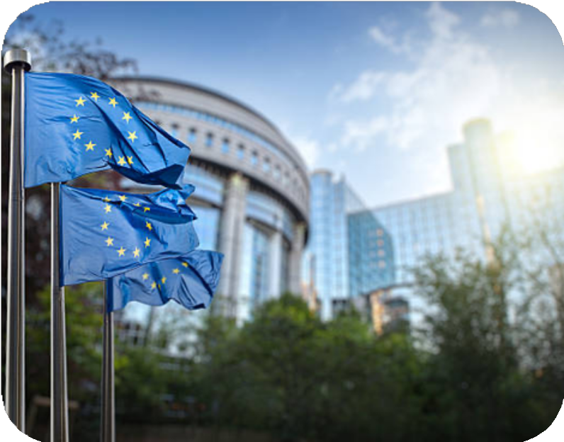
The context of EU
policies on the green and digital transition
European Green Deal
Objective: achieving climate neutrality in the EU by 2050
EU Digital Strategy (Digital Decade 2030)
Focus on digital skills, digital infrastructure, and the digitalisation of services
Fit for 55 legislative package
Reducing greenhouse gas emissions by at least 55% by 2030
“Do No Significant Harm” (DNSH) principle
Projects must not cause significant harm to the environment
AI ACT AND CIRCULAR ECONOMY ACT
Sustainability and digitalisation as horizontal priorities
Increasingly influence project eligibility and evaluation criteria

Slide 5


GREEN AND DIGITAL IS NOT ADDED VALUE, IT IS MUST
The Government of the Republic of Croatia adopted the Decision on the implementation of Green Public Procurement (Official Gazette No. 137/2024), which entered into force on 1 January 2025.
Green Public Procurement (GPP) is an environmental protection instrument that promotes the procurement of goods, services and works with a reduced environmental impact throughout their life cycle.
It is defined as a procedure in which environmental considerations and criteria are taken into account within public procurement processes, ensuring that purchased products, services and works do not cause harm to the environment. Green Public Procurement represents a tool for improving the efficiency of public procurement, while at the same time leveraging the power of the market to enhance the benefits of a healthy environment at local, national and global levels.
GPP IS A TOOL
They are no longer optional “topics”, but a standard. Projects that fail to address
them lose points. They increasingly influence project eligibility and scoring.
Focused on reducing environmental impacts throughout the entire life cycle of products, services and works
An approach to public procurement that integrates environmental criteria into the procurement process
In practice, this includes: energy efficiency reduction of CO₂ emissions product durability
repairability and recyclability reduction of waste and resource consumption
It is based on:
EU policies (Green Deal, DNSH) the public procurement legislative framework
strategic documents (EU and national level)

Slide 6
Why is Green Public Procurement (GPP) becoming increasingly important in EU projects?
It supports the objectives of the European Green Deal and the climate neutrality targets. It ensures compliance with the Do No Significant Harm (DNSH) principle.
It contributes to higher project quality and sustainability.
It increasingly affects eligibility, evaluation criteria and scoring.
It strengthens the long-term impact of projects beyond their implementation period. It aligns projects with EU funding priorities and policy frameworks.

Slide 7

Examples of procurements with green criteria - TYERS
MANDATORY PROCUREMENT OF TYRES WITH EU TYRE LABEL, IN LINE WITH REGULATIONS 1222/2009/EC AND 1235/2011/EU
THE LABEL PROVIDES INFORMATION ON THREE KEY PARAMETERS:
FUEL EFFICIENCY (ROLLING RESISTANCE)
WET GRIP (SAFETY)
EXTERNAL ROLLING NOISE
ENERGY CLASSES RANGE FROM A (BEST) TO E, WHERE HIGHER-CLASS TYRES CONTRIBUTE TO:
LOWER FUEL CONSUMPTION
REDUCED CO₂ EMISSIONS
LOWER OPERATING COSTS
TYRES ACCOUNT FOR 20–30% OF TOTAL VEHICLE FUEL CONSUMPTION, MAKING THEIR SELECTION HIGHLY RELEVANT FOR CLIMATE IMPACT
CROATIAN GPP DECISION (OG 137/2024) INTRODUCES MINIMUM SHARES OF TOP ENERGY CLASS TYRES:
30% FROM 2025
50% FROM 2028
70% FROM 2030

Slide 8

Example of Green Criteria in Procurement – IT Equipment
Environmental aspects through technical specifications:
EPEAT – criteria for energy efficiency, repairability and recyclability
Energy Star – certification of energy efficiency and reduced energy consumption CE marking – basic compliance with EU regulations
RoHS – restriction of hazardous substances (lead, mercury, etc.)
WEEE – rules on electronic waste management and producer responsibility
Environmental aspects through award criteria (example): EPEAT Bronze – 0 points
EPEAT Silver – 2 points EPEAT Gold – 3 points
Enables transparent and objective evaluation of sustainability performance in procurement procedures.

Slide 9
ADDED VALUE EXAMPLES
Area
🖥 IT equipment
📦 Public procurement
🌱 Environment (DNSH)
♿ Digital accessibility
🔐 Data protection
🏗 Buildings
🌐 Digital services
Legal minimum (obligation)
CE marking, RoHS compliance Compliance with Public Procurement Act Project must not cause significant harm WCAG compliance
GDPR compliance nZEB standard Basic digitalisation
Legal basis
Directive 2014/30/EU (CE) Directive 2011/65/EU (RoHS)
Croatian Public Procurement Act (OG 120/16, 114/22)
Regulation (EU) 2021/1060 Regulation (EU) 2020/852 (Taxonomy)
Directive (EU) 2016/2102 Croatian Act OG 17/2019
Regulation (EU) 2016/679 (GDPR) Directive 2010/31/EU (EPBD) National e-government regulations
Added value – where quality is created
EPEAT Silver/Gold, Energy Star
extended warranty, repairability, modular design
Green criteria (durability, CO₂, packaging) ESG-based scoring
LCC (Life-Cycle Costing)
Active measures: reduced resource use, circular economy, waste reduction
UX design for vulnerable groups
multi-channel access (not only web-based)
Privacy by design user trust
digital ethics
A+ energy class renewable energy sources
smart energy management systems
Interoperability once-only principle open data
fewer physical visits for citizens

Slide 10

CLIMATE CHANGE ADAPTATION

Slide 11






DIGITALISATION OF SERVICES OF LOCAL AND REGIONAL SELF- GOVERNMENT AUTHORITIES
DIGITALISATION INCREASES EFFICIENCY AND TRANSPARENCY.
DIGITAL PROCUREMENT
THE NEW EOJN PLATFORM REPRESENTS A CONCRETE EXAMPLE OF DIGITAL TRANSFORMATIO N IN PUBLIC PROCUREMENT
A TOOL FOR MODERNISATION, NOT BUREAUCRACY

Slide 12
DIGITALISATION OF PUBLIC ADMINISTRATION SERVICES - OPEN CALL
ELIGIBLE ACTIVITIES
Development of new e-services covering the entire life or business event Development of new m-services covering the entire life or business event Significant upgrade of existing e-services covering the entire life or business event Significant upgrade of existing m-services covering the entire life or business event
Integration of multiple simple digital services (e-services or m-services) into one complex service
Adaptation of new or existing e-services into m-services available on existing mobile platforms and applicationsdeveloped within the State Information Infrastructure, to enhance citizens’ digital mobility
Development of measures and solutions to increase information system security and reduce the risk of cyberattackson public e-services and m-services
Preparation and delivery of training activities related to the e-service/m-service covered by the project Communication and visibility activities and implementation of horizontal principles
Project management and preparation of the project proposal (where applicable)

Slide 13
DIGITALISATION OF PUBLIC ADMINISTRATION SERVICES
Eligibility requirements
The project complies with the “Do No Significant Harm” (DNSH) principle under Article 9(4) of Regulation (EU) 2021/1060
Appropriate conditions and measures are applied
Additional actions promote the transition to a circular economy, including waste prevention and recycling
Quality assessment
Identification of the project’s concrete contribution to EU objectives in promoting sustainable development and/or supporting the green transition
The applicant has foreseen additional activities beyond legal obligations, contributing to sustainability and green transition, such as:
Examples of added-value measures: Reduction of paper use and physical logistics Re-use of data (once-only principle)
System interoperability
Modular and long-term sustainable IT architecture Energy-efficient hosting
Data analytics for resource optimisation

Slide 14
OTHER FUNDING POSSIBILITIES
CALLS AND TENDERS
Energy renovation of public buildings Proof of innovative concept Digitalisation – for private sector
Loans – HAMAG-BICRO
Financial instrument “Microloans for Growth and Inclusion” aimed at micro and small enterprises
Financed from the European Social Fund Plus (ESF+) under the programme “Efficient Human Resources 2021– 2027”
Loans granted directly to SMEs by HAMAG-BICRO
Implementation aligned with the Do No Significant Harm (DNSH) principle Compliance with relevant EU and national legislation
Programmes
Digital Europe Programme EU Programmes

Slide 15







30 MIN BREAK
SEE YOU AT 12:00
GREEN AND DIGITAL TRANSITION
BLUE ECONOMY
contact: Claudia Pučić Lerotić CL projects, owner
e mail: claudia@clprojects. hr

